Slide 1
Date: 07/27/2018
WELCOME
E-Client
(A perfect Client Management Tool(CMT))
By:
Prabhu Gurung
Pradeep Poudel
Pradip Dhakal

Slide 2
What was the idea ?
Requirement gathering tool
-Gather client functional/non-functional/design requirements.
Client Management Tool
- Visualize ongoing project with progress on bars/circle/chart.
Project Tracking Tool
- Track project with module base/functional base timing

Slide 3
Problem statement
Consumption of time due to traditional & manual in requirement gathering way.
There is a lack of simplicity in others tools performing that task.
Lack of maintenance of data in a proper way.
Missing a small (micro) task that has a crucial advantage while project development.
Data and information are important things to client so lack of assurance and misuse of data by software are largely seen.

Slide 4
Objectives
Able to create wide varieties of projects.
Able to design / Interface of project.
Features to handle users/client details.
Track progress and status of project.
To communicate and collaborate between client and tram members.
More GUI friendly (Dashboard, Tools, Steps).

Slide 5
Where to implement ?
For college project (By student and By teacher)
- By teachers: assign tasks to students and track their progress.
- By student: easily done tasks with steps(simply checked steps).
For client project (software/app/web app)
- Real time rendering design
- Further track working procedure
While doing remote (team) project
- Team can easily done tasks from different geographical location.

Slide 6
Features
Functional Features:
1.1. Level of Authorization
1.2. Project Module
1.3. Communication Module
1.4. Notification Module
1.5. Security Module
2. Non-Functional Features:
2.1. Security
2.2. User Friendly Interface
2.3. Validity of ata
2.4. Performance
2.5. Capability
2.6. Scalibility

Slide 7
Functional Features
1.1. Level of authorization
i. Administrative level:
a. Eclient Admins:
a. Company Admins:
ii. User level:
a. Client User:

Slide 8
Functional Features
1.2. Project Module
i. Project and Module Creation:
ii. Employee Assignment:
iii. Client Creation:
iv. Basic UI design:
v. Module Submit:

Slide 9
Functional Features
1.3. Communication Module
Eclient admin :
Admin to admin
Admin to company admin
ii. Company:
Company admin to company admin
Company admin to client.
iii. Client:
Client to Client
Client to Company (related to only Company project)

Slide 10
Functional Features
1.3. Notification Module
via email:
Email notification notify following activities:
registration of company
approved company
to employee if any module is assigned
forget password
ii. via phone message
approved company
iii. via dashboard notification:
to employee if any module is assigned
assigned project supervisor employee

Slide 11
Functional Features
1.3. Security Module
i. Forget Password:
ii. Remember Me:

Slide 12
Non-Functional Features
Security
User Friendly Interface
Validity of Data
Performance (Response time, throughput, utilization, static volumetric)
Capacity
Availability
Scalability
Manageability
Environmental
Usability
Interoperability

Slide 13
Management Plan
10 Days
7 Days
23 Days
10 Days
10 Days
Feasibility Study
Wireframe / Interface
System Development
System Testing
Implementation

Slide 14
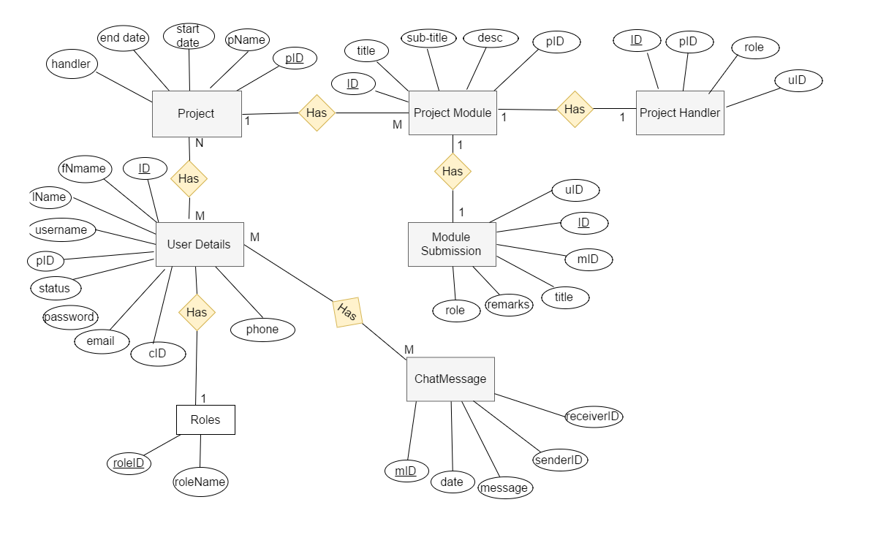
ER Diagram

Slide 15
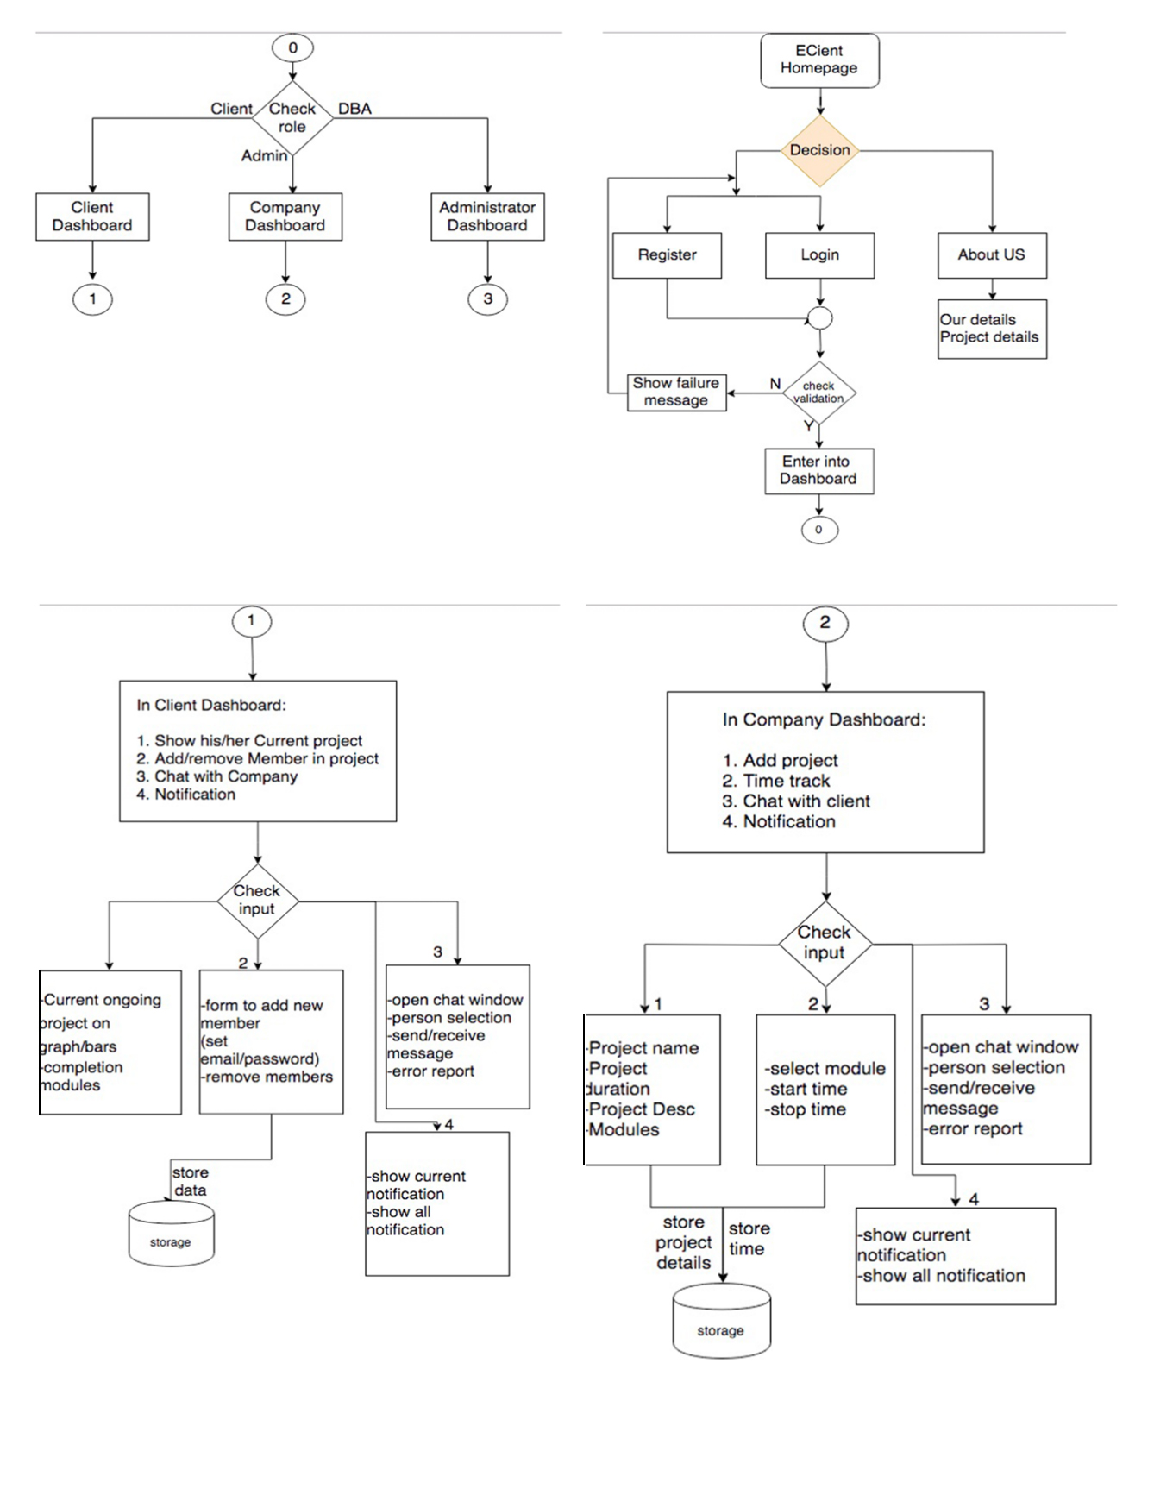
System Flowchart Diagram

Slide 16
System Flowchart Diagram

Slide 17
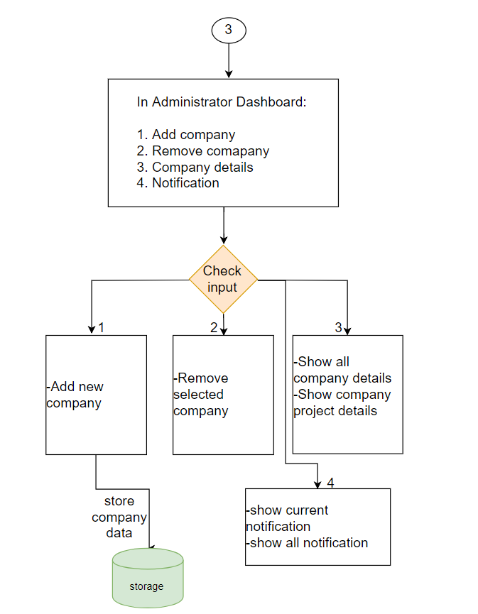
System Flowchart Diagram

Slide 18
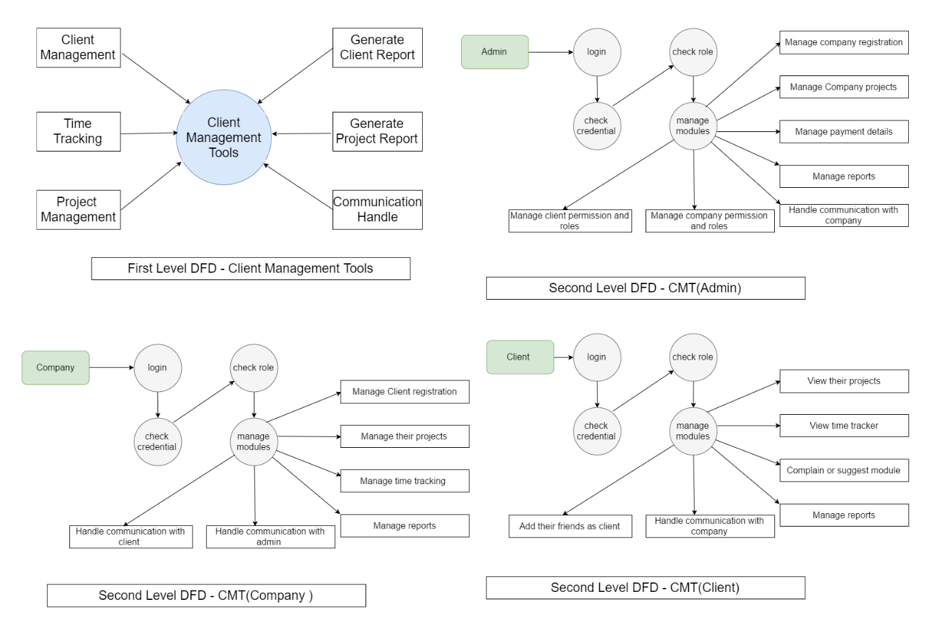
Data Flow Diagram

Slide 19
Implementation Areas and Application
a. School / College / University.
-Teachers can easily assign project to their students and track that project assignment.
b. Company / Organization / Business.
-With different level of authorization different task are involved.

Slide 20
Application Development
Application Development(Frontend)
a. Design and Markup HTML5/CSS3/Bootstrap/SASS
Server Side (Back-end):
PHP: Hypertext Preprocessor
Apache Server
MySql
PHP Unit
Gitlab
TokBox Sdk

Slide 21
Conclusion
Supposed to used by any business.
b. To maximize efficiency and work by different necessary tools.
c. It provides a facility to maintain a data in a proper way.

Slide 22
Thank You
For your Attendance
ANY QUESTIONS ?

